Slide 1
Optimizing Retirement Account Distributions
Stanislaus County Estate Planning Council
Fall Seminar 2026
Michael Abram, PhD, CFA
Principal & Portfolio Manager
Integral Wealth Management

Slide 2
Disclaimer
This talk is intended for general educational purposes, and nothing should be construed as investment, legal, or tax advice.
Please consult your financial professionals for advice specific to your situation.

Slide 3
Agenda
Motivation
Optimization Framework
Income tax and “true” marginal tax
Distribution Rules for IRAs
Distribution Rules for Inherited IRAs
Trusts as IRA Beneficiaries
Roth Conversions
Summary/Learning Objectives

Slide 4
Motivation
The estate planning team of attorney, accountant, and advisor is tasked with meeting each client’s goals of:
  Providing for surviving spouse
  Transferring wealth to the next generation
  Charitable giving
  Minimizing taxes
  Controlling how and when beneficiaries receive wealth
Thesis: The flexibility to time distributions from retirement accounts during relatively lower tax years provides an opportunity to optimize wealth especially with recent changes due to Secure Act, Secure Act 2.0, and the One Big Beautiful Bill Act

Slide 5
Poll: Preferences Across Account Types
Would you rather have $100 in an IRA or $X in a taxable account?
Would you rather have $100 in a taxable account or $X in a Roth?
Upshot: Account type (pre-tax, post-tax, taxable) matters and so does the distributor’s tax situation (and possibly the distributor’s tax drag/asset allocation in taxable account)

Slide 6
Case Study: Mom has $1M IRA and $1M Trust, wants to leave $400k to charity, and remainder to Daughter (25% bracket)
Estate Plan A
Trust provides specific bequest to charity of $400k with remainder to Daughter
IRA left entirely to Daughter
Outcome
Charity gets $400k
Daughter gets $1.35M after taxes
Government gets $250k
Estate Plan B
IRA left 40% to charity and 60% to Daughter
Trust left entirely to Daughter
Outcome
Charity gets $400k
Daughter gets $1.45M after taxes
Government gets $150k

Slide 7
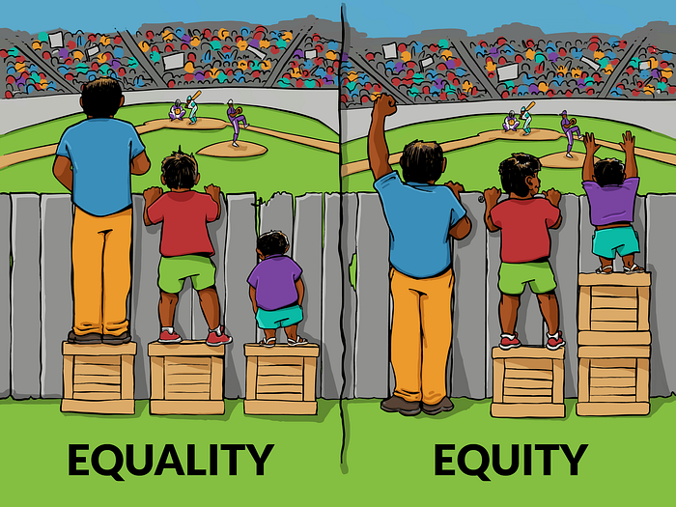
Equality versus Equity

Slide 8
Case Study: Mom has $1M IRA and $1M Trust to leave to Daughter (40% bracket) and Son (25% bracket)
Estate Plan A (Equality)
Trust divided 50/50
IRA divided 50/50
Outcome
Daughter gets $800k after taxes
Son gets $875k after taxes
Government gets $325k
Estate Plan B (Equity)
IRA left entirely to son
Trust left 87.5% to Daughter and 12.5% to Son
Outcome
Daughter gets $875k after taxes
Son gets $875k after taxes
Government gets $250k

Slide 9
Optimization Framework
Consider the life of the account (which may continue after death)
Decide who is taking a distribution
Compute after-tax values for distributor’s tax situation
Compare after-tax end of plan values for various scenarios
Understand quantitatively the cost of the tradeoff
Conduct sensitivity analysis by varying the assumptions

Slide 10
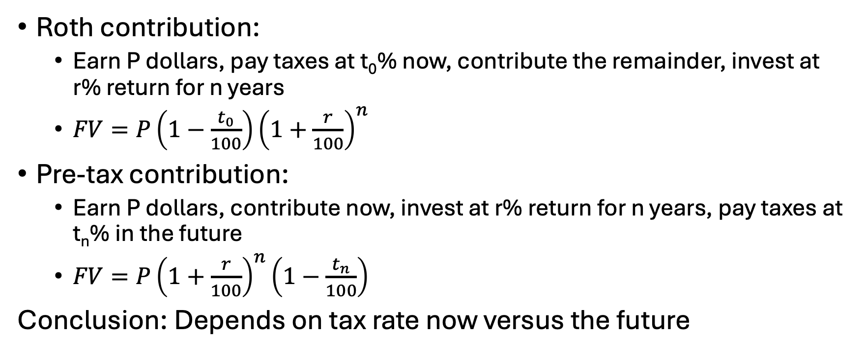
Is tax deferral always better?
Roth contribution:
  Earn P dollars, pay taxes at t₀% now, contribute the remainder, invest at r% return for n years
  $FV=P\left(1−\frac{t_{0}}{100}\right){\left(1+\frac{r}{100}\right)}^{n}$
Pre-tax contribution:
  Earn P dollars, contribute now, invest at r% return for n years, pay taxes at t_{n}% in the future
  $FV=P{\left(1+\frac{r}{100}\right)}^{n}\left(1−\frac{t_{n}}{100}\right)$
Conclusion: Depends on tax rate now versus the future

Slide 11
What is your future tax bracket?
Depends on your income
  Salary/Pension
  Inheritance
  Investment returns
  IRA distribution amount
Depends on your tax filing status
Depends on tax law
  Current brackets are low historically
  Congress could change brackets, tax rates, and/or deductions
  Government deficit is high

Slide 12
Tax Computation Walkthrough
Income | Wages
-Adjustments | Tips
Adjusted Gross Income (AGI) | Interest
-Deductions | Dividends
Taxable Income | IRA distributions
↓ | Pensions and annuities
Tax | Social security benefits
-Credits | Capital gains
-Payments | Alimony received (pre-2019 agreement)
Owe/Refund | Rental property income
Notes:
All income is reported but not all is taxable or taxed at the same rates

Slide 13
Tax Computation Walkthrough
Income | IRA contribution
-Adjustments | Health savings account (HSA) contribution
Adjusted Gross Income (AGI) | Alimony paid (pre-2019 agreement)
-Deductions | Partial deduction for charitable contributions [starting 2026]
Taxable Income
↓
Tax
-Credits
-Payments
Owe/Refund
Notes:
Educator expenses moves from Adjustments to Deductions in 2026
For an HSA, you need a high-deductible health insurance plan (no eligible for Medicare recipients)
For IRA contributions, you or your spouse must have earned income (not investment, pension, or social security income). Deductibility further depends on access to an employer plan and income limits.
Above-the-line charitable deduction is $1,000 per filer starting in 2026 and must be a cash contribution directly to a charity (not a DAF and not property)

Slide 14
Tax Computation Walkthrough
Income | used for determining eligibility for:
-Adjustments | Tax credits
Adjusted Gross Income (AGI) | Itemized deductions for medical expenses
-Deductions | Itemized deductions for charitable gifts
Taxable Income | Enhanced SALT deduction limit
↓ | Enhanced Senior deduction
Tax | Deductibility of IRA contributions
-Credits | Roth IRA contributions
-Payments | Health insurance subsidies/premiums
Owe/Refund | Loans/Mortgages
Notes:
Notice the “line” as items are considered “above-the-line” or “below-the-line”

Slide 15
Tax Computation Walkthrough
Income | Standard deduction ⩼ Itemized deductions
-Adjustments | Medical and dental expenses above 7.5% of AGI
Adjusted Gross Income (AGI) | State and local taxes (subject to phase out)
-Deductions | Mortgage interest
Taxable Income | Charitable contributions above 0.5% of AGI [2026]
↓ | Etc.
Tax | +
-Credits | Additional deductions (tips, overtime, car loan interest)
-Payments | +
Owe/Refund | Senior deduction and Enhanced senior deduction
Notes:
Examples later on

Slide 16
Tax Computation Walkthrough
Income | Taxable income is the input to calculate your tax
-Adjustments | Capital gain income stacks on top of ordinary income
Adjusted Gross Income (AGI) | Capital gain income uses a lower set of tax brackets
-Deductions | Adjustments and deductions subtract ordinary income first
Taxable Income
↓
Tax
-Credits
-Payments
Owe/Refund

Slide 17
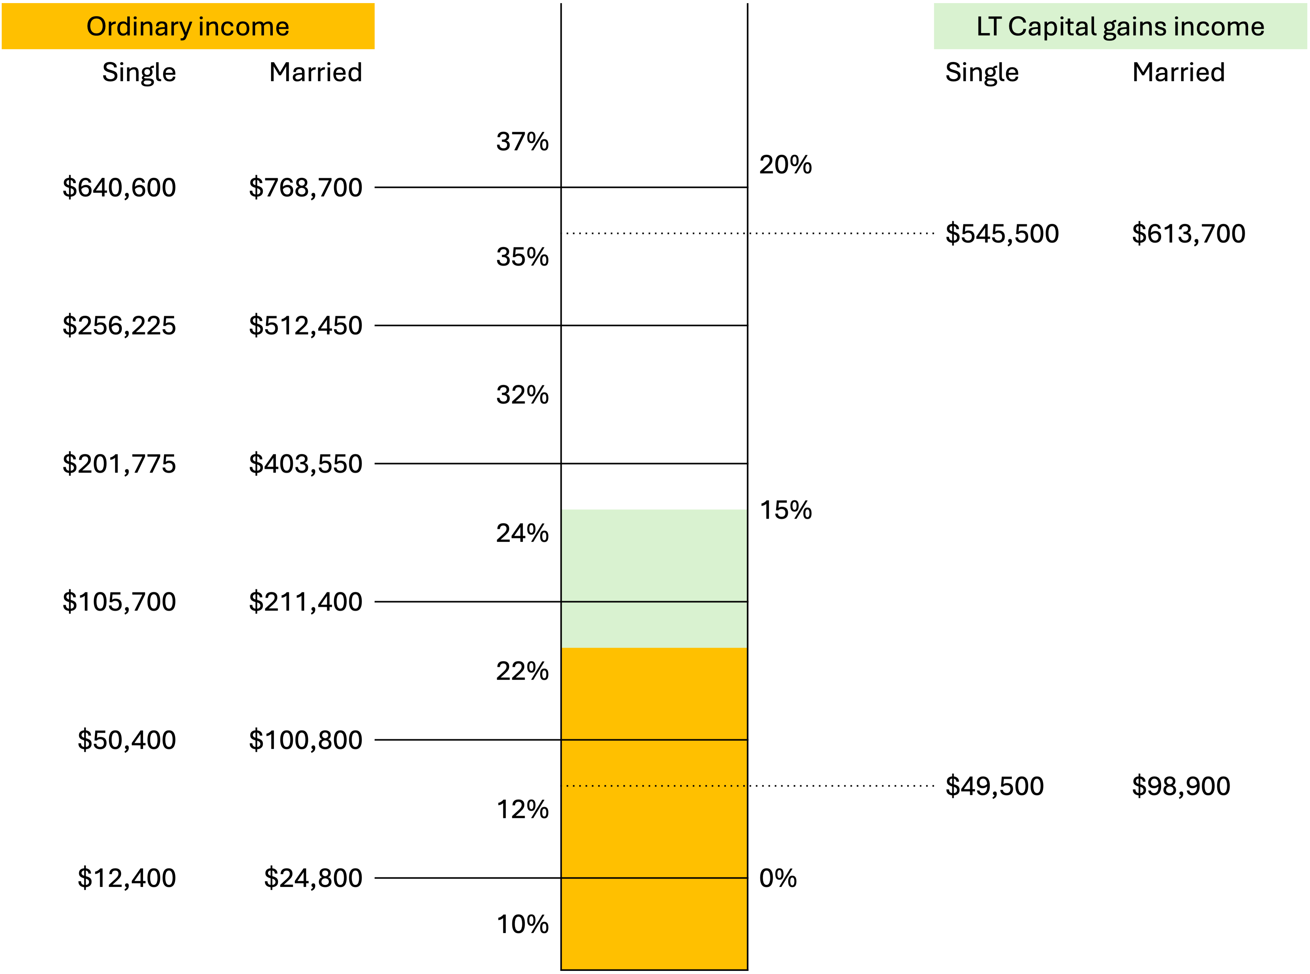
Notes:
Visualize the calculation as a beaker where each section will be taxed at a different rate
Filing status changes the thresholds
Not drawn to scale but you get the idea

Slide 18
Tax Computation Walkthrough
Income | Child tax credit
-Adjustments | Earned income tax credit
Adjusted Gross Income (AGI) | American opportunity tax credit
-Deductions | Child and dependent care tax credit
Taxable Income
↓
Tax
-Credits
-Payments
Owe/Refund
Notes:
Child tax credit (2k per child subject to income limits; phasing out between 200k to 240k for single MAGI and 400k to 480k for joint MAGI)
Earned income tax credit (need some income but not too much and the amount depends on number of children)
American opportunity tax credit is $2,500 for qualified higher education expenses (phasing out between 80-90k single MAGI and 160-180k joint MAGI)
Child and dependent care tax credit for qualified childcare so a parent can work or look for work (20% of expenses up to 3k per child under 13)

Slide 19
Tax Computation Walkthrough
Income | Tax withheld from W-2
-Adjustments | Tax withheld from 1099
Adjusted Gross Income (AGI) | Estimated tax payments
-Deductions
Taxable Income | Safe harbor to avoid penalties
↓ | Withhold 90% of current year’s tax obligation
Tax | Withhold 100-110% of last year’s tax obligation
-Credits
-Payments
Owe/Refund
Notes:
Pay-as-you-go system; Withholdings are treated as being paid evenly throughout the year
Estimated tax payments are good for interest, dividends, gains that are perhaps less predictable
Penalty is about 7-8% applied quarterly; Additional penalties for failing to file or pay

Slide 20
Tax Computation Walkthrough
Income | Amount you owe
-Adjustments | +
Adjusted Gross Income (AGI) | Estimated tax penalty
-Deductions
Taxable Income | OR
↓
Tax | Refund of overpaid taxes
-Credits
-Payments
Owe/Refund
Notes:
If you get a refund, it means you essentially gave the government an interest-free loan
Budgeting-wise, some people over-withhold as forced savings or a bonus check

Slide 21
But wait, there are more taxes!
Net Investment Income Tax
3.8% on the lesser of:
  investment income (interest, dividends, gains, rental income); or
  MAGI minus $200k (or $250k for joint filers)
Additional Medicare Tax
0.9% on earned income over $200k (or $250k for joint filers)

Slide 22
But wait, there are more taxes!
Income-Related Monthly Adjustment Amount (IRMAA) is a surcharge on Medicare Part B and Part D premiums for high earners
Based on your AGI + Tax-exempt interest (Modified AGI or MAGI)
Has a two-year lag, so 2026 premiums are based on 2024 income
Thresholds are “cliffed” so one dollar over triggers the next level

Slide 23
Tax Impact of $1 More of AGI
Marginal tax rate
  Tax bracket applied to the next $1 of taxable income
“True” marginal tax rate
  Percent of the next $1 of adjusted gross income that is lost to taxes or surcharges either directly or indirectly (via a reduction of deductions)
Are deductions reduced?
  Enhanced senior deduction
  State and Local Taxes (SALT) deduction
  Itemized charitable donations subject to a floor of 0.5% of AGI
  Itemized medical and dental expenses subject to a floor of 7.5% of AGI
Are capital gains pushed to another bracket?
What about Net Investment Income tax?
Does it push you over the next cliff for Medicare surcharges (Income-Related Monthly Adjustment Amount)?

Slide 24
Case Study: Husband and Wife (both 66) have $100k of pension income, $80k of gains, and $60k of medical expenses
AGI: $180k
Itemized > Standard deduction
60-.075(180)=$46,500
Senior deduction: $1,650 x 2
Enhanced Sr. deduction:
$4,200 x 2
Taxable income: $121,800
Tax computation:
24,800 x 10% = 2,480
17,000 x 12% = 2,040
57,100 x 0% = 0
22,900 x 15% = 3,435
Federal taxes: $7,955

Slide 25
Case Study: Husband and Wife (both 66) have $100k of pension income, $80k of gains, and $60k of medical expenses and also took a $10k IRA distribution
AGI: $180k $190k
Itemized > Standard deduction
60-.075(190)=$46,500 $45,750
Senior deduction: $1,650 x 2
Enhanced Sr. deduction:
$4,200 $3,600 x 2
Taxable inc.: $121,800 $133,750
Tax computation:
24,800 x 10% = 2,480
28,950 x 12% = 3,474
45,150 x 0% = 0
34,850 x 15% = 5,228
Federal taxes: $7,955 $11,182
Nets $6,773 of $10k distribution

Slide 26
Case Study: Husband and Wife (both 64) have $122,200 of pension income and $160k of tax-exempt interest
AGI: $122,200
Standard deduction: $32,200
Taxable income: $90,000
Tax computation:
24,800 x 10% = 2,480
65,200 x 12% = 7,824
Federal taxes: $10,304
Two years later…
1st 2028 IRMAA tier: $229k
2nd 2028 IRMAA tier: $288k
2026 MAGI: $282,200
IRMAA: $105 x 12 x 2 = $2,520

Slide 27
Case Study: Husband and Wife (both 64) have $122,200 of pension income and $160k of tax-exempt interest and also took a $10k IRA distribution
AGI: $122,200 $132,200
Standard deduction: $32,200
Taxable income: $100,000
Tax computation:
24,800 x 10% = 2,480
75,200 x 12% = 7,824 9,024
Federal taxes: $10,304 $11,504
Two years later…
1st 2028 IRMAA tier: $229k
2nd 2028 IRMAA tier: $288k
2026 MAGI: $282,200 $292,200
IRMAA: $105 x 12 x 2 = $2,520
$265 x 12 x 2 = $6,360
Nets $4,960 of $10k distribution

Slide 28
Required Minimum Distributions (RMDs)
IRA owners must distribute a minimum percentage each year once they hit a certain age
Birth date/year | Age turned in 2026 | Age RMDs begin
Before July 1, 1949 | 77.5 and older | 70.5
July 1, 1949-December 31, 1950 | 76-77.5 | 72
1951-1959 | 67-75 | 73
1960-present | 66 and younger | 75
Uniform Life Table | Factor | % of 12/31 balance
Age 73 | 26.5 | 3.78%
Age 78 | 22.0 | 4.55%
Age 83 | 17.7 | 5.65%
Age 88 | 13.7 | 7.30%

Slide 29
Other RMD highlights
Your Required Beginning Date (RBD) is April 1st of the year following when you turn your RMD age
Delaying your first RMD means there will be two RMDs in that year
There are penalties for failing to take RMDs, but those penalties can be reduced if corrected quickly
There is a joint life table for IRA owners whose spouses are sole beneficiaries and are more than 10 years younger
Roth IRAs (and now Roth 401k’s due to Secure Act 2.0) are not subject to RMDs (it is considered always before your RBD)

Slide 30
Qualified Charitable Distributions (QCDs)
QCDs are payments from your IRA or Inherited IRA directly to a public charity
Each tax filer over 70.5 can make a QCD of up to $111,000 in 2026
QCDs count towards RMD requirements
QCDs do not increase your AGI
You do not need to itemize to get “credit” for a QCD
QCDs cannot go into a Donor Advised Fund

Slide 31
Inherited IRAs prior to 2020
If IRA owner died prior to 2020, beneficiaries may:
Rollover funds into own IRA (spouses only);
Distribute the entire balance by the end of the fifth year after death; or
“Stretch” distributions over the beneficiary’s single life expectancy (subtracting one from the factor each subsequent year).
Single Life Table | Factor | % of 12/31 balance
Age 63 | 24.5 | 4.08%
Age 68 | 20.4 | 4.90%
Age 73 | 16.4 | 6.10%
Age 78 | 12.6 | 7.94%
Age 83 | 9.3 | 10.75%
Age 88 | 6.6 | 15.15%

Slide 32
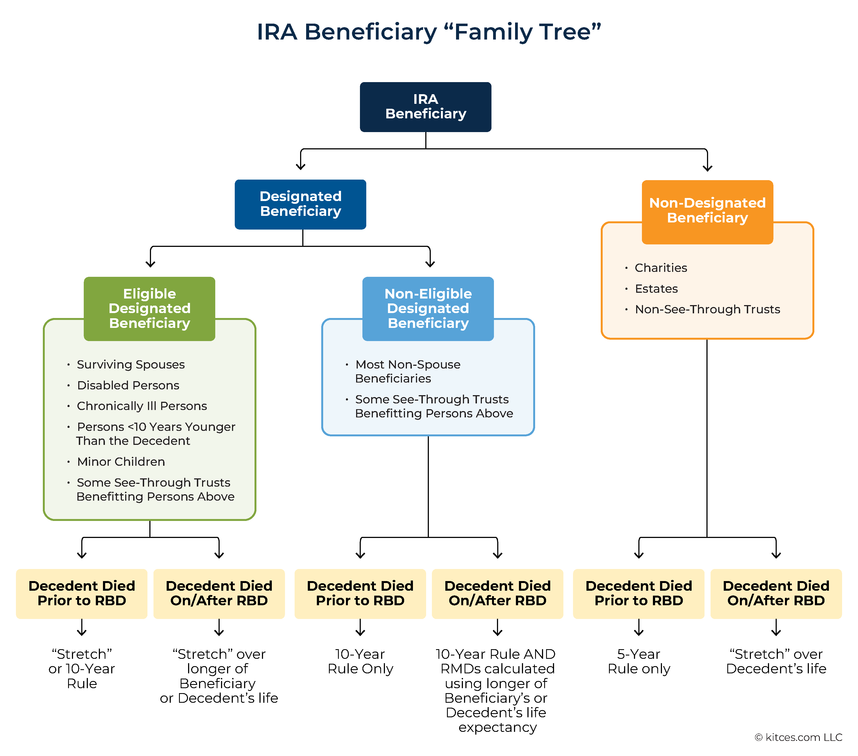
Post-2020

Slide 33
Surviving Spouse Inheritance Options
If under 59.5, you may want to keep as an Inherited IRA to take distributions without penalty
If over 59.5 (or not in need of distributions) and younger than deceased spouse, you may want to roll it over to your own IRA for a delayed RMD age and lower factors
Closed loophole: If deceased spouse died prior to RBD, you could keep as an Inherited IRA and use the 10-year rule to delay RMDs past your RBD and then roll it over to your own IRA to benefit from the lower factors (uniform as opposed to single life). You now must withdraw “hypothetical” RMDs for the ones you skipped.

Slide 34
Case Study: Mom dies after RBD, leaving $1M IRA to Son (age 60)
Son is subject to 10-year rule and annual RMDs over his single life
  Projected RMDs using a 6% return assumption
    Year 1: $36,900.37
    Year 2: $39,199.22
    Year 3: $41,644.88
    Year 4: $44,247.25
    Year 5: $47,017.01
    Year 6: $49,965.68
    Year 7: $53,105.70
    Year 8: $56,450.57
    Year 9: $60,014.94
    Year 10: $1,224,350.30

Slide 35
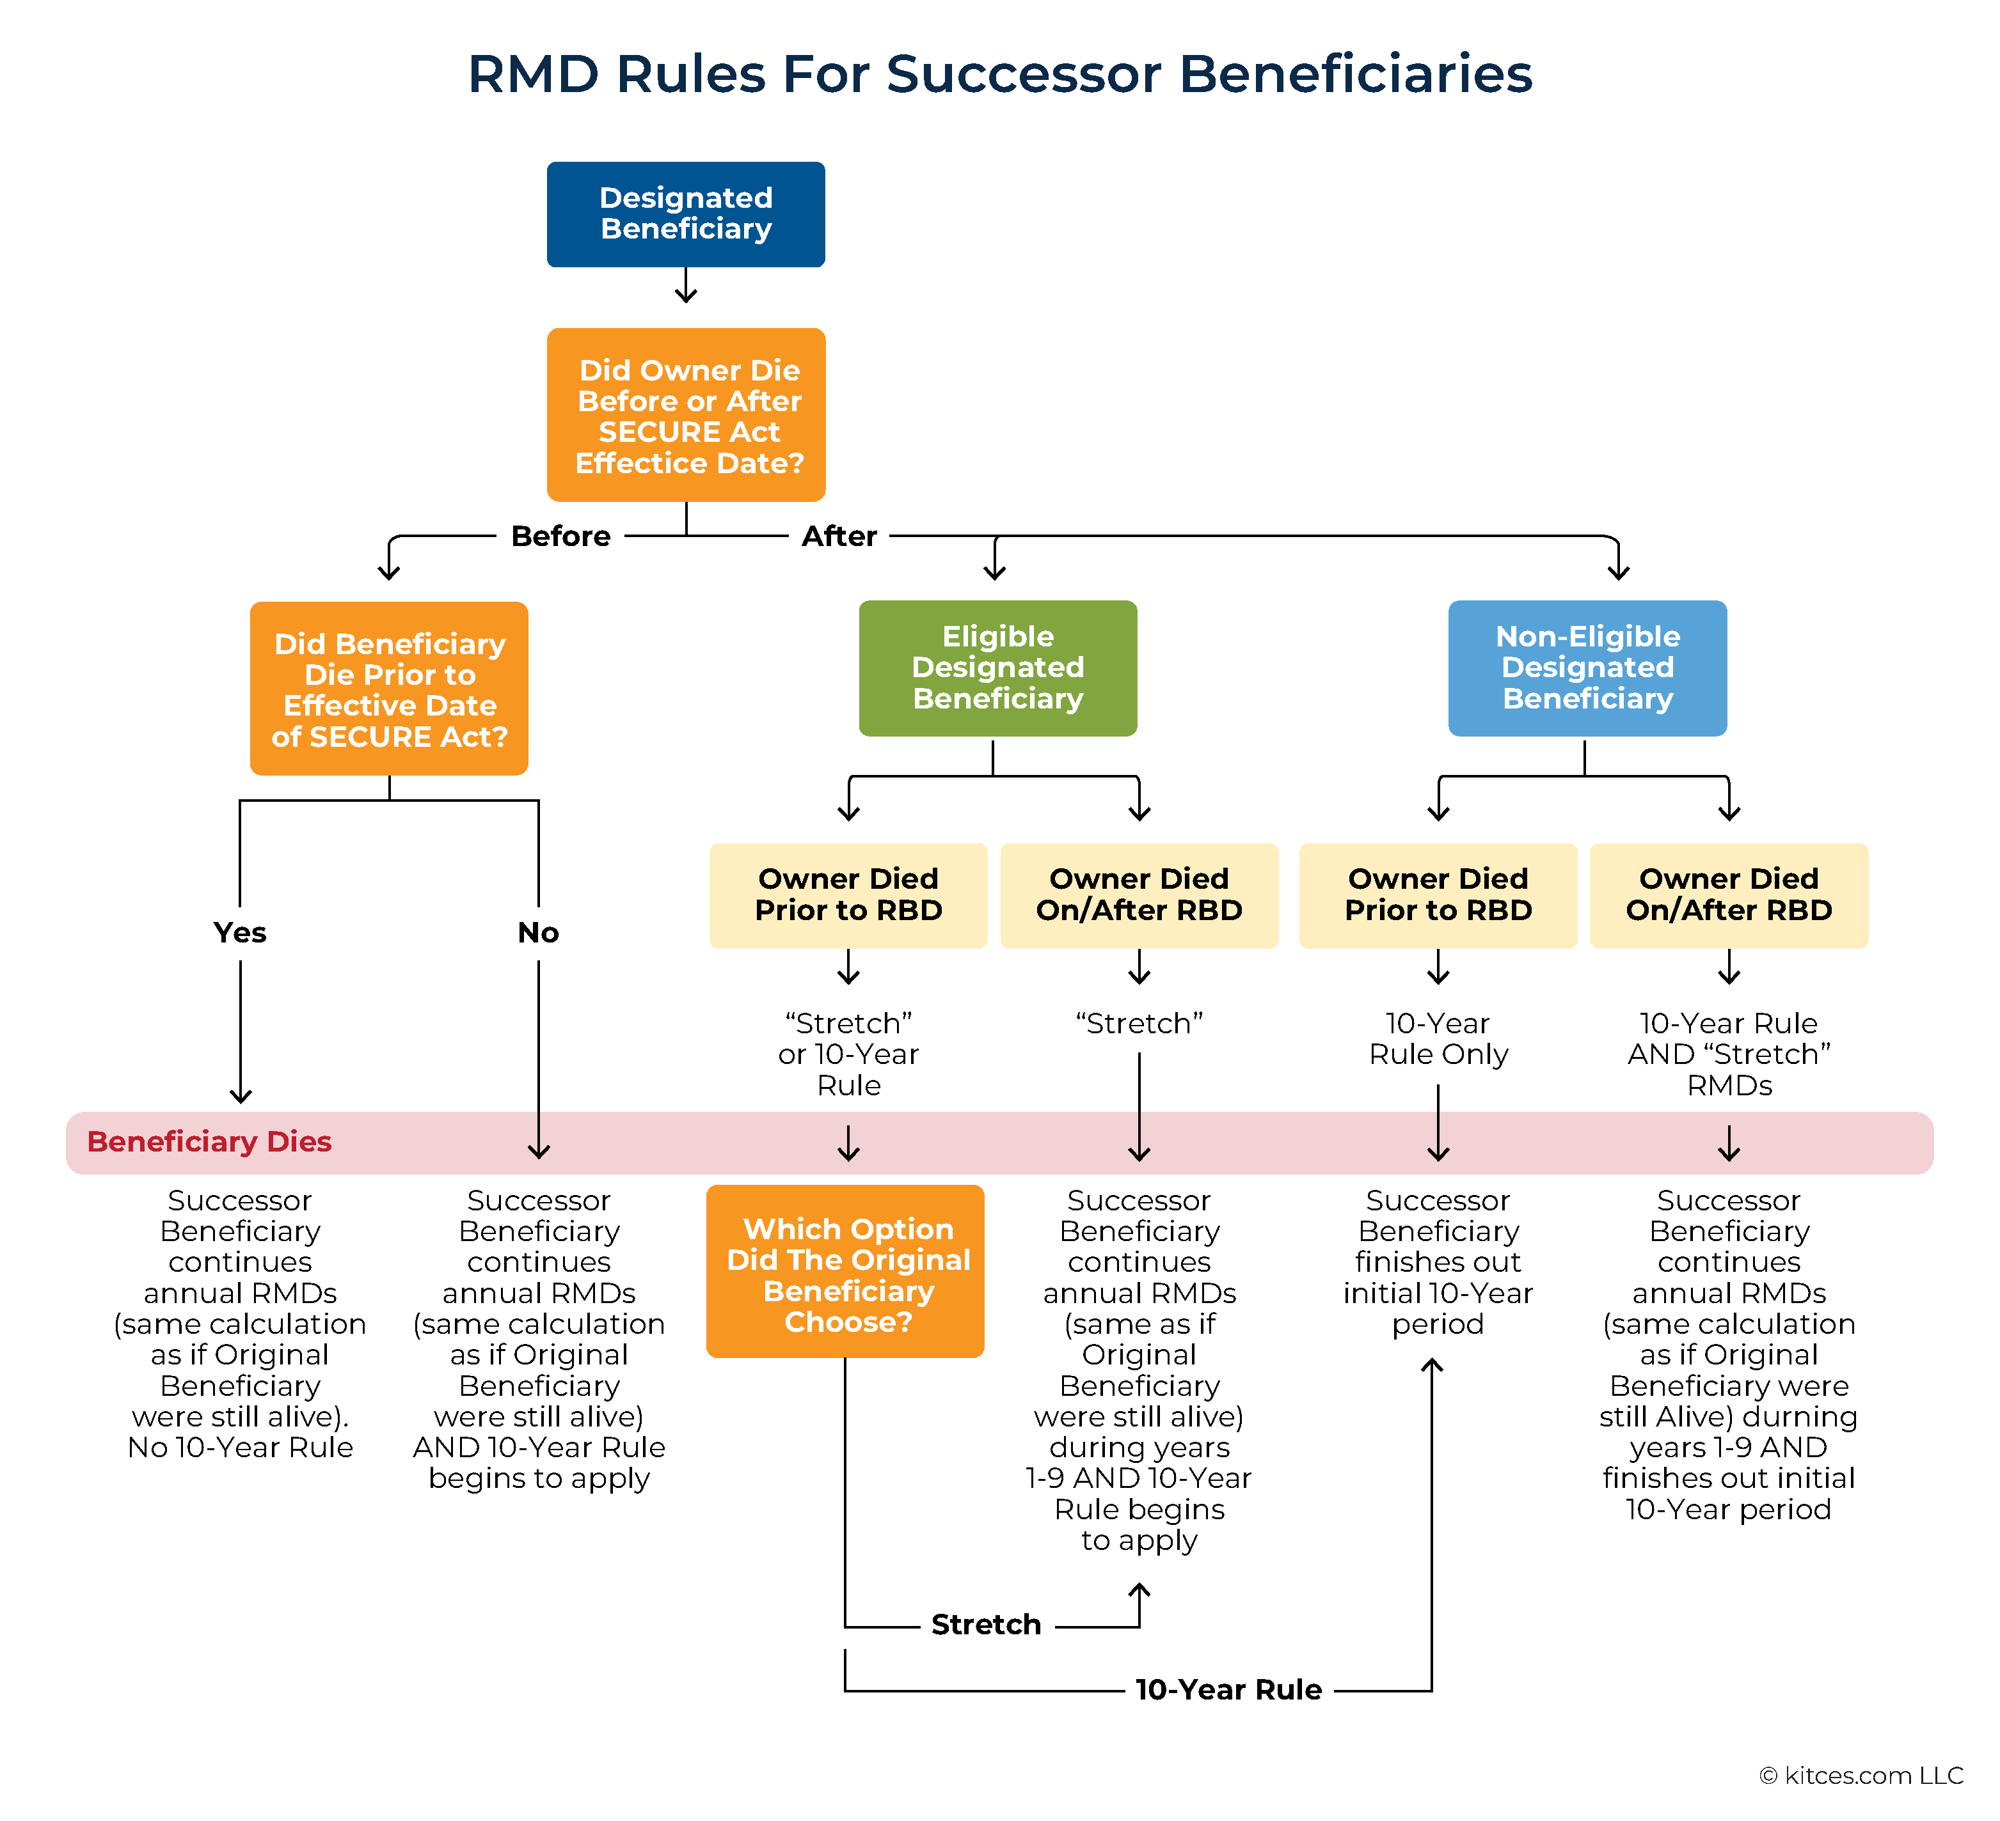

Slide 36
Designating a Trust as an IRA Beneficiary
Pros:
Asset protection from beneficiary’s lawsuits, creditors, and divorce settlements
Spendthrift control
Preserving public benefits
Successor beneficiary control for blended families
Cons:
Higher complexity and cost for planning and administration
Retained income faces higher tax rates at lower thresholds
Payout timelines could vary depending on drafting

Slide 37
See-Through Trusts
Must meet 4 requirements:
  Valid under state law
  Irrevocable upon death
  Identifiable beneficiaries (either named individuals or classes like “my children”; cannot include charities, estates, or trusts)
  Documentation must be provided to IRA custodian by October 31 following year of death
A see-through trust can control an Inherited IRA but be treated as a (non)-eligible designated beneficiary for distribution purposes
Separate distribution schedules can be used provided:
  “Master” trust named as IRA beneficiary is a see-through trust
  Trust must state immediate division into subtrusts
  No discretion by trustee on asset division
  [Treas. Reg. Section 1.401(a)(9)-8(a)(iii)(B)]

Slide 38
Conduit vs. Accumulation Trusts
Conduit trusts require the trustee to distribute IRA distributions to the trust beneficiary
  Avoids trust tax issues
  Allows for some asset protection and control
  If 10-year rule applies, conduit trust has limited timeline
Accumulation trusts allow trustee to retain and accumulate Inherited IRA distributions inside the trust
  Retained Inherited IRA distributions would be taxed to the trust
  Allows greater asset protection and control

Slide 39
Creative Strategies Aren’t Always Better
Emulate “stretch” using a Charitable Remainder Unitrust (CRUT)
  Exits IRA tax free
  Payouts between 5% and 50% to your beneficiary over their lifetime or up to 20 years (subject to tax)
  Present value of remainder interest to charity must be at least 10%
  Outcomes vary considerably based on age and interest rates, add complexity, give up flexibility to take larger distributions, and require outliving your break-even point
Intentionally use Non-Designated Trusts in a certain window
  If owner dies after RBD and was between 74 and 80, her single life expectancy factor could lead to 11- to 15-year distribution period
  If desired, you could leave 1% to charity to disqualify as see-through trust

Slide 40
Roth conversions
Transfer a portion of your IRA to your Roth IRA
A Roth conversion is taxable (and could be paid by outside funds)
Not subject to income limits like contributions are
Follow 5-year rules to avoid taxes and/or penalties when withdrawing converted principal or earnings
You can view it as pre-paying taxes for your heirs or otherwise hedging your future tax liability

Slide 41
Case Study: Husband and Wife (both 64) typically take IRA distributions of $350,000.
Filing Jointly
Standard deduction: $32,200
Tax computation:
24,800 x 10% = 2,480
76,000 x 12% = 9,120
110,600 x 22% = 24,332
106,400 x 24% = 25,536
Federal taxes: $61,468
Compare to a single filer
Standard deduction: $16,100
Tax computation:
12,400 x 10% = 1,240
38,000 x 12% = 4,560
55,300 x 22% = 12,166
96,075 x 24% = 23,058
54,450 x 32% = 17,424
77,675 x 35% = 27,186
Federal taxes: $85,634; $24,166 more
“Widow’s tax penalty”

Slide 42
Summary/Learning Objectives
Compare values in pre-tax, taxable, and post-tax accounts
Identify how an increase to AGI differs from an increase to taxable income
Explore extra taxes or surcharges like Net Investment Income Tax and IRMAA
Learn about RMD factors, beginning dates, QCDs, and Roth conversions
Distinguish between different classes of IRA beneficiary
Apply the proper RMD rules for primary and successor beneficiaries of an IRA
Explore the impact of using see-through, conduit, and/or accumulation trusts as IRA beneficiaries
Synthesize these topics to find optimal scenarios for transferring wealth to surviving spouses, children, and/or charities

Slide 43
Case Study: Husband (68) and Wife (70) have $2.75M IRA and three beneficiaries
Doing just the minimum distributions eventually puts them in the 24% bracket (and misses out on low tax years before RMDs begin)
One pre-mature death puts them in the 35% bracket
Two pre-mature deaths would see their three kids inherit nearly $1M in an Inherited IRA and be subject to the 10-year rule during their highest earning years (32-35% brackets)
Potential advice: Do Roth conversions to fill up the 24% bracket for the next 3 years to hedge against higher future rates, lower future RMDs, get tax-free growth, and pre-pay taxes for your heirs at relatively lower rates
Analysis: Adds approx. $7M (in today’s dollars) of after-tax value in 30 years relative to doing just the minimum

Slide 44
Questions?
Thank you for your attention!
mike@integral-wealth.com

