Slide 1
Are Your Clients Ready for an IRS Examination?
November 7, 2018
Estate Planning Council of Stanislaus County
Debra Estrem, National Managing Director,
Private Wealth Tax Controversy
Deloitte Tax LLP

Slide 2
What is New at the IRS?

Slide 3
Budget Constraints Continue to Drive Changes at IRS
IRS
Resources
Continue
To Be
Cut
  FY17 Budget $11.2 billion:
    IRS has lost almost a billion from its budget since FY10 in steadily decreasing funding
    IRS responsibilities increase as funding decreases
      Administering the new tax bill and partnership exam rules will be challenging
  The IRS is doing more with less
    Service Center correspondence projects
    Campaign approach to business exams
    Focus on certain taxpayers and issues that are more likely to yield results
  Training and travel substantially reduced since FY10
    Face to face meetings may be more difficult to schedule
    Agents and Appeals Officers may work from home

Slide 4
Retirements Continue with Limited Hiring
Retirements Are
Looming
  Over 40% of managers and 50% of executives were eligible to retire in 2016
  Almost 25% of overall workforce was eligible to retire in 2016 and this increases to 40% over next 3 years
  Practically no millennials are employed by the IRS
  Revenue agents down about 25% since FY10
    Over 21,000 fewer employees since FY10
    Some new hires in certain areas, significantly SB/SE, including estate and gift tax agents

Slide 5
Morale Low But Starting to Improve
Acting
Mangers Create Challenges
  Many open supervisory positions are designated as “acting,” so new supervisor receives more responsibility but no grade/salary increase
    Management decision-making can be impacted
  Effect of job uncertainty with new administration and leadership
  Management, agents, and administrative services are often in disparate locations

Slide 6


New IRS Commissioner
Chuck Rettig is Sworn is as IRS Commissioner
The White House has tapped a well-known Beverly Hills tax attorney to be the next Commissioner.
Rettig will face the challenge of implementing the new $1.5 trillion “tax reform” law passed last year, despite substantial cuts to the IRS budget since 2010.
Breaks a 20-year precedent of IRS leaders having backgrounds in business or management, but not tax.
The IRS Commissioner is “responsible for the administration and enforcement of the Internal Revenue laws”
Notes:
Born November 18, 1956, in Burbank, California, Charles Paul (Chuck) Rettig earned a B.A. in Economics at the University of California at Los Angeles in 1978, a J.D. at Pepperdine University Law School in 1981, and an LL.M. in Taxation at New York University Law School in 1982.
Soon after graduating with his second law degree, Rettig joined the law firm now known as Hochman, Salkin, Rettig, Toscher & Perez, which specializes in tax law. A certified specialist in tax, estate planning, and trust and probate law, Rettig has spent his entire 35-year career there. He focuses on settling tax controversy cases between tax collectors and his wealthy clients, which have included Michael Jackson, Don Ho, “Girls Gone Wild” creator Joseph Francis and many corporations. He has represented clients before the IRS, the Justice Department Tax Division, and various other tax authorities.

Slide 7

New IRS Chief Counsel
Michael J. Desmond to be Named IRS Chief Counsel
Michael J. Desmond, a prominent tax lawyer, is nominated to be the Chief Counsel for the IRS and Assistant General Counsel in the Department of Treasury.
Mr. Desmond has alternated between private practice and public service in the DOJ and Treasury, and has been running his own law firm in Santa Barbara, California, since 2012.
The IRS Chief Counsel is the chief legal advisor to the IRS Commissioner on all matters pertaining to the interpretation, administration, and enforcement of the Internal Revenue Code, as well as all other legal matters.
Notes:
Born November 18, 1956, in Burbank, California, Charles Paul (Chuck) Rettig earned a B.A. in Economics at the University of California at Los Angeles in 1978, a J.D. at Pepperdine University Law School in 1981, and an LL.M. in Taxation at New York University Law School in 1982.
Soon after graduating with his second law degree, Rettig joined the law firm now known as Hochman, Salkin, Rettig, Toscher & Perez, which specializes in tax law. A certified specialist in tax, estate planning, and trust and probate law, Rettig has spent his entire 35-year career there. He focuses on settling tax controversy cases between tax collectors and his wealthy clients, which have included Michael Jackson, Don Ho, “Girls Gone Wild” creator Joseph Francis and many corporations. He has represented clients before the IRS, the Justice Department Tax Division, and various other tax authorities. Trump’s returns?

Slide 8

The likelihood of IRS examination
Tip:
As adjusted gross income (“AGI”) rises, so does the likelihood of examination. Individuals with adjusted gross income of over $1 million are more likely to be subject to examination, with coverage rates
over 25 percent for those with AGI exceeding $1 million. Current IRS initiatives, including GHW examinations, foreign income reporting, transfer pricing, employment tax and other focus areas, suggest that private wealth taxpayers and family offices should be prepared for the possibility of an examination.
It is helpful for taxpayers to do periodic risk assessments before an examination begins. These risk assessments can range from a simple discussion with internal advisors to a detailed examination readiness assessment that includes document reviews and interviews. The goal is to identify material issues that could become a focus on examination, prepare for examination of these items, and confirm that there is a system in place for addressing potential government information requests.
Size of adjusted gross income on return | Returns filed in Calendar Year 2016 (percent of total) | Examination coverage in Fiscal Year 2017 (percent)
No adjusted gross income | 1.69 | 3.55
$1 – $25,000 | 36.47 | 0.71
$25,000 – $50,000 | 23.33 | 0.49
$50,000 – $75,000 | 13.26 | 0.48
$75,000 – $100,000 | 8.59 | 0.45
$100,000 – $200,000 | 12.19 | 0.47
$200,000 – $500,000 | 3.6 | 0.7
$500,000 – $1,000,000 | 0.58 | 1.56
$1,000,000 – $10,000,000 or more | 0.29 | 25.99
Source: IRS Data Book for 2017

Slide 9
What is the Progression of an IRS Examination?

Slide 10
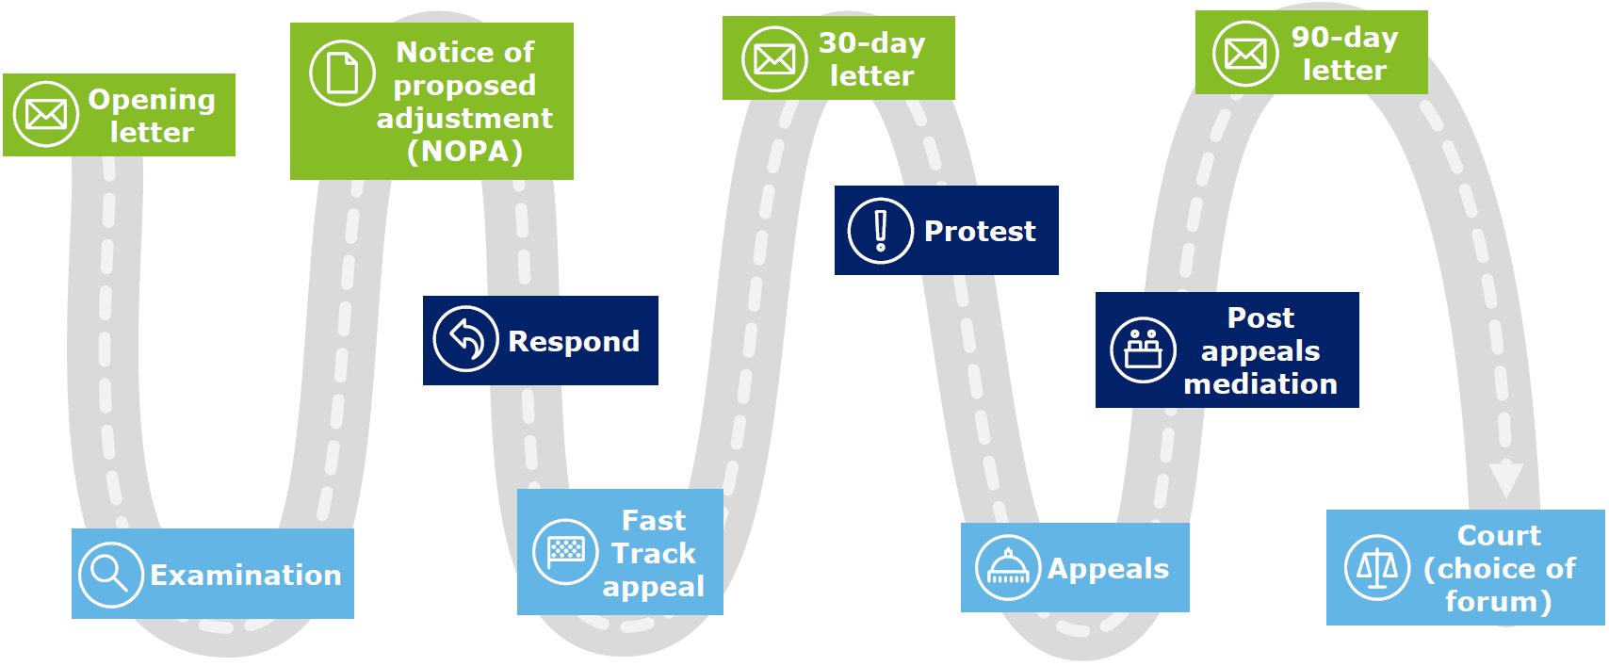

Tax Controversy Process
Notes:
Time Spent on This Slide:
1 to 3 minutes
Materials and/or Actions:
Review the information on the slide.
Key Speaking Points:
[Placeholder]
Transition to Next Slide:
No formal transition is necessary.

Slide 11
The Examination Begins…
Most examinations begin with a letter to schedule an initial appointment.
Following the initial meeting, the examiner will likely define proposed material examination issues and begin to issue information document requests. These should be in draft form.
Agent may ask for a tour of business premises. Agent may ask for an interview of taxpayer or third parties. Agent may ask to work at taxpayer business site.
Examiners are often under pressure to complete examinations in a timely manner, so be prepared for expedited turnaround time.
Historically, average time to complete a traditional individual examination has been about 12 to 18 months, although the timeframe could depend on the complexity of the issues involved.

Slide 12
SB/SE Division About 54 Million Taxpayers under Jurisdiction
Includes Estate and Gift Tax, Employment Tax, Excise Tax, certain International Areas.
  SB/SE examines:
  Individual filings
  Form 1040, including schedules C, E, F
  All other businesses with assets under $10 million
  Gift and estate tax returns—no matter how large
  --Agents are Attorneys
  --Estate tax statutes cannot be extended
  Employment tax—may be substantial examinations

Slide 13
LB&I Division About 210,000 taxpayers under Jurisdiction
Recently announced a realignment and shift to issue focused examinations or “campaigns”
  Now Five Substantive Practice Areas:
  • Pass-through Entities,
  • Withholding & International and Individual Compliance,
  • Cross-Border Activities,
  • Treaty and Transfer Pricing Compliance, and
  • Enterprise Activities (Financial Institutions and Products, Corporate Issues, Credit and Penalties)
  Now Four Geographic Practice Areas:
  Western (Oakland); Central (Houston); Eastern (Downers Grove); and Northeastern (New York)

Slide 14
IRS Campaign Approach (LB&I only)
The Campaign Approach:
  Intent is to use the collective knowledge of the entire organization to identify and focus on the recognized risks of non-compliance
  Deploy IRS limited resources against those risks
  Designed to change taxpayer behavior
  Revenue Agents will be given instructions on what issues to explore and how the examinations should be conducted
  Centrally selected issues managed by “issue teams”
  Goal is for IRS to be more effective in its audits
Notes:
On January 31, 2017, the IRS announced its initial 13 campaigns. The nine domestic campaigns are:
Section 48C Energy Credits for renewable energy projects and projects designed to reduce greenhouse gasses;
Micro Captive Insurance;
Deferred Variable Annuity Reserves and Life Insurance Reserves;
Section 199 Deductions claimed by Multi Channel Video Programming Distributors and Television Broadcasters;
Related Party Transactions that provide a means to transfer funds from a corporation to related pass-through entities or shareholders;
Basket Option Contracts used by hedge funds to convert short term investments into long term investments;
Land Developers using the Completed Contract Method;
TEFRA Partnership Linkage with terminal investors; and
S Corporation Losses claimed in excess of BasisThe four international campaigns announced were:
Repatriation transactions being used for tax-free repatriation in the mid-market section;
1120-F non-filers;
Transfer Pricing for Inbound Distributors; and
Off-shore Voluntary Disclosure Program (“OVDP”) Decliners.

Slide 15
What Are the Options for Resolving an IRS Dispute?

Slide 16
Practice Pointer:
Should My Client Agree to IRS Facts in Notices of Proposed Adjustment?
In the past few years, there are growing instances of IRS Examination requiring a taxpayer to agree to a “Fact Statement” drafted by them.
Be aware that how this is handled can potentially have long-lasting implications.
Any response should be carefully considered.

Slide 17
IRS Fast Track Appeal
Fast Track is a voluntary, non-binding process and can be initiated either by the taxpayer or the IRS examination team.
Fast Track is an IRS expedited dispute resolution program that takes place during the examination phase. The goal is to resolve issues earlier in the process and more quickly than traditional approaches.
Fast Track occurs after one or more issues have been defined in a notice of proposed adjustment, but before the formal closure of the examination. During the Fast Track proceedings, the IRS examination team and the taxpayer will engage in negotiations with an IRS appeals officer acting as a neutral third party.

Slide 18
IRS Appeals and Post-Appeals Mediation
IRS appeals is a fresh look at a taxpayer’s IRS dispute in which the examination team has limited or no involvement.
Appeals differs from the examination function in many ways, but one of the more important differences is appeals’ settlement authority. While examination must resolve issues purely based on its determination of the facts and law, as interpreted by the Commissioner, appeals can settle an issue taking into consideration the hazards of litigation.
Post-appeals mediation is a non-binding extension of the appeals process that uses the services of a mediator, either a different, specially-trained IRS appeals officer, or an outside mediator, to help reach settlement. The mediator will act as a facilitator, assisting in defining the issues and promoting settlement between appeals and the taxpayer.

Slide 19
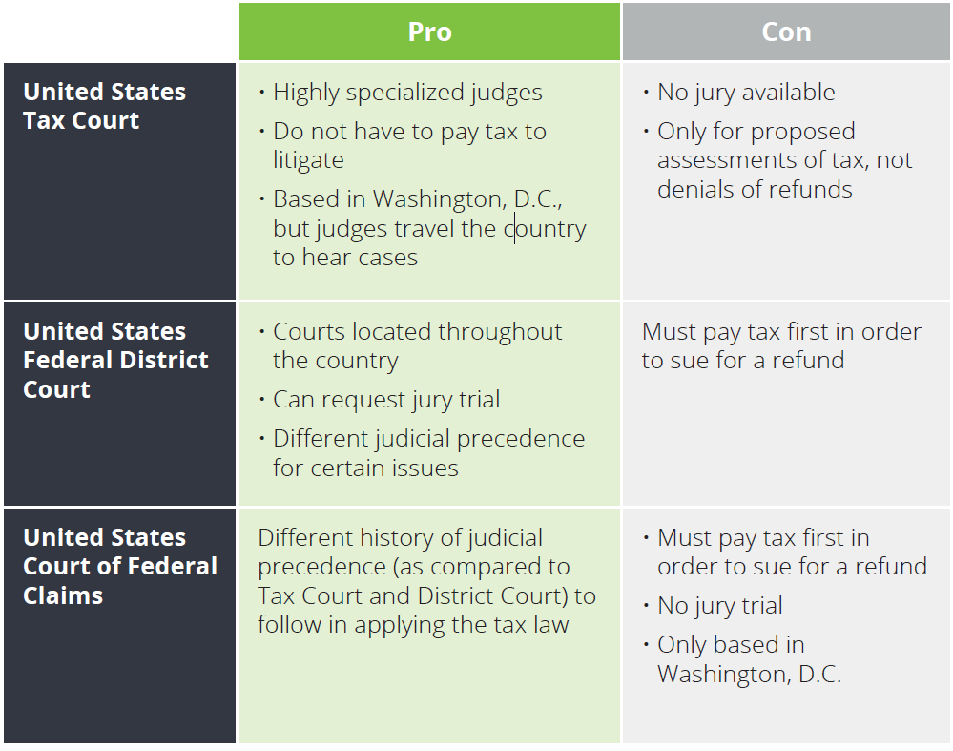
Litigation
If all other dispute resolution options do not produce a successful outcome, then taxpayers have three alternative judicial forums for litigating their federal tax controversies.
Generally, trial proceedings in all three forums are open to the public. The media can access most court filings and trial records, and these can become public news items.

Slide 20
What’s New with IRS Appeals?

Slide 21
Changes in Appeals:
--Fewer In-Person Meetings -----Inviting Agents, Counsel to Meetings
In 2016, the IRS changed its policy regarding in-person appeals conferences to resolve disputes in less burdensome ways, such as telephone or virtual conferences.
The tax bar provided feedback as to the advantages of in person conferences.
At a September 2017 ABA conference in Austin, Texas, IRS Appeals clarified that, for field cases worked by revenue agents, taxpayers may still receive in-person conferences, despite recent pronouncements that phone conferences are the preferred or default method.
In practice, in person meetings are limited.
Appeals recently starting inviting other IRS personnel into taxpayer settlement discussions.
On May 1, 2017, the IRS issued FAQs making clear that Exam will now be routinely invited to Appeals conferences.
Recent press as
this issue
is discussed

Slide 22
How to be Ready for an IRS Exam
*Income Tax, Estate and Gift Tax
*What is a Global High Wealth Exam?

Slide 23
Requirement to Maintain Books and Records
  Section 6001: Maintenance of books and records sufficient to establish matters required to be shown on a tax return
  Treas. Reg. § 1.6001-1(d): A Notice of Inadequate Records may be issued if a taxpayer fails to comply with relevant “record retention” revenue procedures
Defining “Records”
    Rev. Rul. 71-20 expands the definition of “records” to include:
      Electronic data that is used for recording, consolidating, and summarizing accounting transactions and records within an automatic data processing system
    Rev. Proc. 91-59, Rev. Proc. 98-25:
      Electronic data must contain sufficient information to support and verify entries made on the taxpayer’s books and taxpayer’s tax return
      Electronic records must generally be provided
Notes:
Time Spent on This Slide:
1 to 3 minutes
Materials and/or Actions:
Review the information on the slide.
Key Speaking Points:
[Placeholder]
Transition to Next Slide:
No formal transition is necessary.

Slide 24
Global High Wealth Industry (GHW)
Substantially Evolving
Charged with strengthening the examination process for high income individuals
Established in late 2009 to provide closer scrutiny of wealthy individuals and their related entities; exam may include:
−Partnership income
− Interests in foreign assets
−Complex planning techniques designed to reduce income
GHW exam may also include:
−A family office, itself, or an entity whose affairs the family office manages
−Review may extend to business entities, other family members, private foundations/charitable giving, retirement plans, gift and estate

Slide 25

Preparing for an IRS Examination
Start with the following...
Perform risk analysis
    Analyze areas of vulnerability
  Study results of prior IRS and state examinations
Read any public communications about client
    IRS will search the Internet
Review relevant IRS Campaign Issues and Audit Technique Guides
Understand the process
Assemble your exam team
Notes:
Time Spent on This Slide:
1 to 3 minutes
Materials and/or Actions:
Review the information on the slide.
Key Speaking Points:
Discuss individual tax situations to understand and analyze risk points, for example:
Incomplete tax records
Procedural or IT system weaknesses
Reportable transaction and other disclosures
Information reporting
Weak tax positions
Identify high risk areas.
Do you have foreign accounts and/or file information returns?
Do you have large foreign tax credits?
Have you taken large charitable contributions or have valuations issues?
Do you have significant basis in partnership interest to claim losses?
Are there public sources of information that the IRS will be reviewing? Public sources not limited to newspapers. IRS will utilize all available online information.
Can provide background about the IRS examination landscape, including recent changes.
Can also discuss how to manage risks discovered in the assessment.
Typically prepared for client’s attorney under a Kovel engagement.
Transition to Next Slide:
No formal transition is necessary.

Slide 26
Preparing for an IRS Examination (cont.)
Scope of Preparations
Can range from:
  A simple discussion of examination procedures, to
Detailed examination readiness assessment that includes IDRs, responses, document reviews, and interviews, followed by a full report
Question: When should an attorney be involved?
Notes:
Time Spent on This Slide:
1 to 3 minutes
Materials and/or Actions:
Review the information on the slide.
Key Speaking Points:
[Placeholder]
Transition to Next Slide:
No formal transition is necessary.

Slide 27

Preparing for an IRS Examination (cont.)
Common IRS examination issues include...
  Passive activity losses
  Employment taxes
  Information reporting
  Withholding issues
Residency issues
Hobby loss issues
Aircraft issues
Charitable issues
Notes:
Time Spent on This Slide:
1 to 3 minutes
Materials and/or Actions:
Review the information on the slide.
Key Speaking Points:
[Placeholder]
Transition to Next Slide:
No formal transition is necessary.

Slide 28
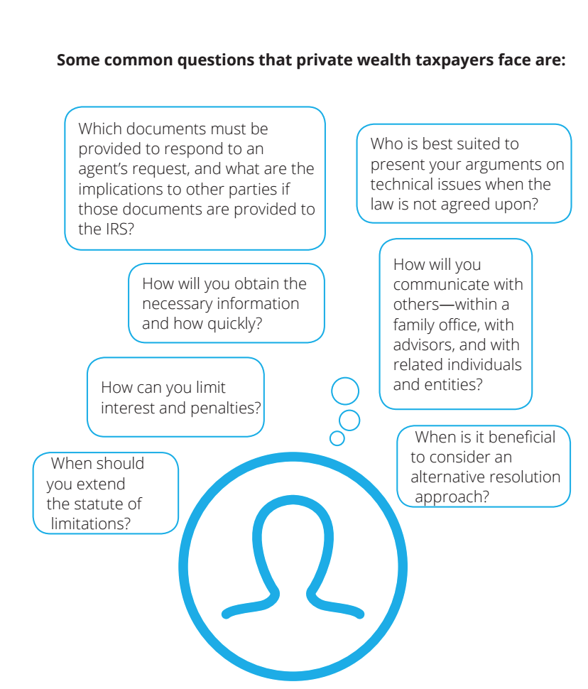

Slide 29
Procedure for “Mock Exam”
1. Review documents, which may include:
Organizational documents and Board minutes
Compensation documentation
Payroll processes and reports, payroll return filings, fringe benefit accounting, and expense reimbursements
Worker classification documents
Employee handbook and hiring procedures
Policies for document retention and destruction
Cost-sharing agreements and related books and records
Publicly available information (e.g., websites, social media, and brochures)
Policies and procedures for recordkeeping and internal controls
Employee benefit plan and accountable plan
2. Conduct limited sample selections of certain documentation for compliance with the tax authorities
3. Interview key personnel about relevant operations, policies, and procedures
Notes:
Time Spent on This Slide:
1 to 3 minutes
Materials and/or Actions:
Review the information on the slide.
Key Speaking Points:
[Placeholder]
Transition to Next Slide:
No formal transition is necessary.

Slide 30
Examples of IRS Readiness
    High profile individual
      Considering political career and release of tax return to the public
      Multiple charities and political contributions
    Services provided
      Full assessment of year 1 tax return
      Became ongoing annual project
    Highly complex individual
      Multiple business lines
      Airplanes
      Residency issues
      Employment tax considerations
      Charitable contributions
      Mix of business and personal expenses
      Private foundation
      Transitions within the family office
    Services provided
      Full IRS readiness assessment
      Focus on documentation and procedures
    Individual concerned
    with a particular issue
      Status as a real estate professional
    Services provided
      Assessment of specified issue and related documentation
Notes:
Time Spent on This Slide:
1 to 3 minutes
Materials and/or Actions:
Review the information on the slide.
Key Speaking Points:
[Placeholder]
Transition to Next Slide:
No formal transition is necessary.

Slide 31

Private Wealth Tax Controversies Brochure
Notes:
Time Spent on This Slide:
1 minute or less
Materials and/or Actions:
Speak to the brochure.
Key Speaking Points:
[Placeholder]
Transition to Next Slide:
No formal transition is necessary.

Slide 32
About this Presentation
This presentation contains general information only and Deloitte is not, by means of this presentation, rendering accounting, business, financial, investment, legal, tax, or other professional advice or services. This presentation is not a substitute for such professional advice or services, nor should it be used as a basis for any decision or action that may affect your business. Before making any decision or taking any action that may affect your business, you should consult a qualified professional advisor. Deloitte shall not be responsible for any loss sustained by any person who relies on this presentation.

